Slide 1
DATA MINING Clustering
The k-means algorithm
Hierarchical Clustering

Slide 2
What is a Clustering?
A grouping of objects such that the objects in a group (cluster) are similar (or related) to one another and different from (or unrelated to) the objects in other groups (clusters)
Inter-cluster distances are maximized
Intra-cluster distances are minimized

Slide 3
Why Cluster Analysis
Understanding
Group related documents for browsing, genes and proteins that have similar functionality, stocks with similar price fluctuations, users with same behavior
Summarization
Reduce the size of large data sets
Applications
Recommendation systems
Search Personalization

Slide 4
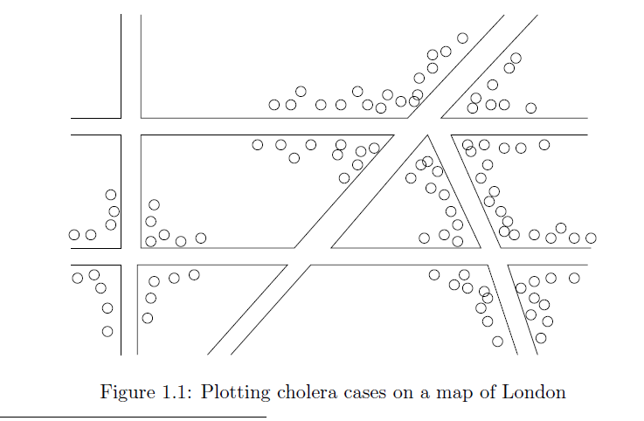
Early applications of cluster analysis
John Snow, London 1854

Slide 5
Notion of a Cluster can be Ambiguous
How many clusters?
Six Clusters
Two Clusters
Four Clusters

Slide 6
Types of Clusterings
Important distinction between hierarchical and partitional sets of clusters
Partitional Clustering
A division data objects into subsets (clusters) such that each data object is in exactly one subset
Hierarchical clustering
A set of nested clusters organized as a hierarchical tree

Slide 7
Partitional Clustering
Original Points
A Partitional Clustering

Slide 8










Hierarchical Clustering
$$C_{5}$$
$$C_{4}$$
$$C_{3}$$
$$C_{1}$$
$$C_{5}$$
$$C_{4}$$
$$C_{3}$$
$$C_{2}$$
$$C_{1}$$
$$C_{2}$$
Hierarchical Clustering dendrogram
Hierarchical Clustering

Slide 9
Clustering objectives
Well-Separated Clusters:
A cluster is a set of points such that any point in a cluster is closer (or more similar) to every other point in the cluster than to any point not in the cluster.
《导论》P309
3 well-separated clusters

Slide 10
Clustering objectives
Center-based Clusters:
A cluster is a set of objects such that an object in a cluster is closer (more similar) to the “center” of a cluster, than to the center of any other cluster
The center of a cluster is often a centroid, the minimizer of distances from all the points in the cluster
4 center-based clusters

Slide 11
Clustering objectives
Contiguous Clusters (Nearest neighbor or Transitive)
A cluster is a set of points such that for any point in the cluster, its nearest neighbor is in the same cluster.
8 contiguous clusters

Slide 12
Clustering Objectives
Density-based clusters
A cluster is a dense region of points, which is separated by low-density regions, from other regions of high density.
Used when the clusters are irregular or intertwined, and when noise and outliers are present.
6 density-based clusters

Slide 13
Clustering objectives
Shared Property or Conceptual Clusters
Finds clusters that share some common property or represent a particular concept.
A cluster is defined as a set of points that lie on a circle

Slide 14
Clustering Algorithms
K-means and its variants
Hierarchical clustering
DBSCAN

Slide 15
K-means

Slide 16
K-means Clustering
Partitional clustering approach
Each cluster is associated with a centroid (center point)
Each point is assigned to the cluster with the closest centroid
Number of clusters, K, must be specified
The objective is to:
find K centroids and
the assignment of points to clusters/centroids
so as to minimize the sum of distances of the points to their respective centroid

Slide 17
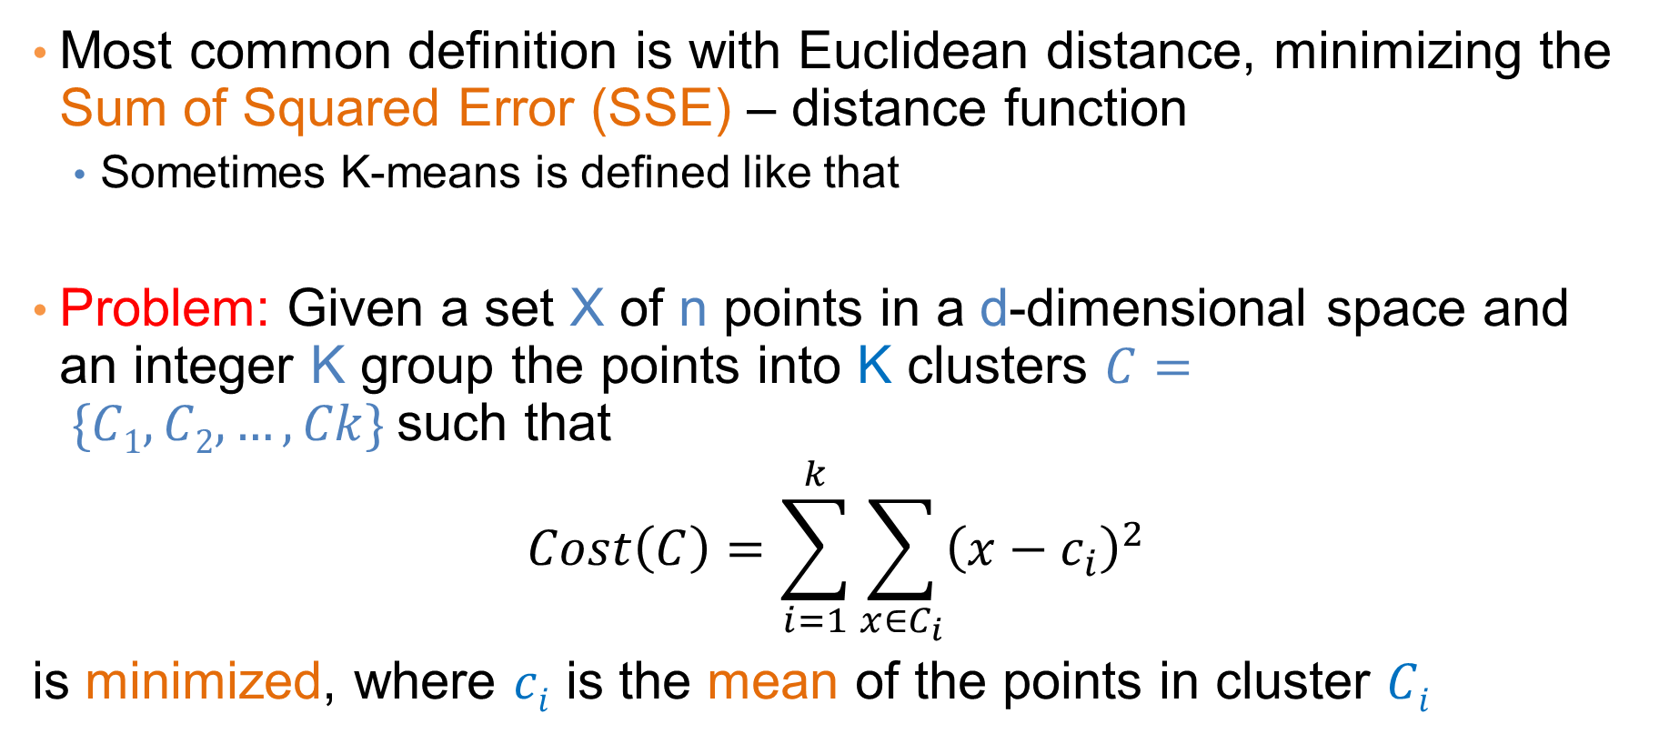
K-means Clustering
Most common definition is with Euclidean distance, minimizing the Sum of Squared Error (SSE) – distance function
Sometimes K-means is defined like that
Problem: Given a set X of n points in a d-dimensional space and an integer K group the points into K clusters $C= \{C1, C2,…,Ck\}$such that
$$Cost\left(C\right)=\sum_{i=1}^{k}{\sum_{x∈C_{i}}{{\left(x−c_{i}\right)}^{2}}}$$
is minimized, where $ci$ is the mean of the points in cluster $Ci$
Sum of Squared Error (SSE)

Slide 18
Complexity of the k-means problem
NP-hard if the dimensionality of the data is at least 2 (d≥2)
Finding the best solution in polynomial time is infeasible

Slide 19
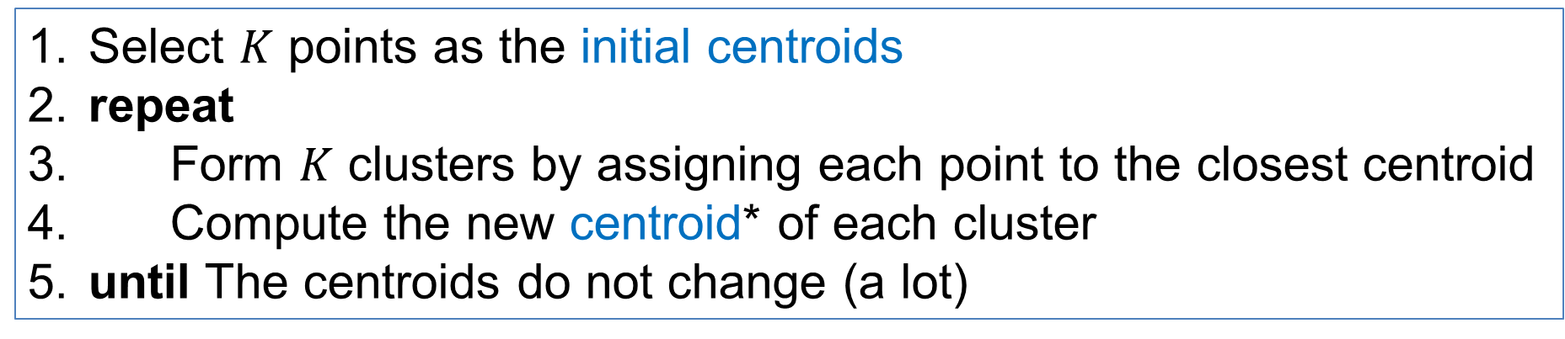
K-means Algorithm
Also known as Lloyd’s algorithm.
K-means is sometimes synonymous with this algorithm
Select $K$ points as the initial centroids
repeat
Form $K$ clusters by assigning each point to the closest centroid
Compute the new centroid* of each cluster
until The centroids do not change (a lot)
e.g. take mean of all points in a cluster to compute its centroid
*The centroid of a set of points is the point that minimizes the sum of distances from the points in the set

Slide 20
Example

Slide 21
Example

Slide 22
K-means Algorithm – Initialization
Initial centroids are often chosen randomly.
Clusters produced vary from one run to another.

Slide 23
Two different K-means Clusterings
Original Points
Optimal Clustering
Sub-optimal Clustering

Slide 24
Importance of Choosing Initial Centroids

Slide 25
Importance of Choosing Initial Centroids …

Slide 26
Dealing with Initialization
Do multiple runs and select the clustering with the smallest error
Select original set of points by methods other than random. E.g., 1. pick one center; 2. when picking the next center, pick the most distant (from previously picked centers) point as cluster center (K-means++ algorithm); 3. repeat 2.

Slide 27
K-means Algorithm – Convergence
K-means will converge for common similarity measures mentioned above.
Most of the convergence happens in the first few iterations.
Often the stopping condition is changed to ‘Until relatively few points change clusters’
Complexity is O( n * K * I * d )
n = number of points,
K = number of clusters,
I = number of iterations,
d = dimensionality
In general a fast and efficient algorithm

Slide 28
Limitations of K-means
K-means has problems when clusters are of different:
sizes
densities
non-globular shapes
K-means has problems when the data contains outliers.

Slide 29
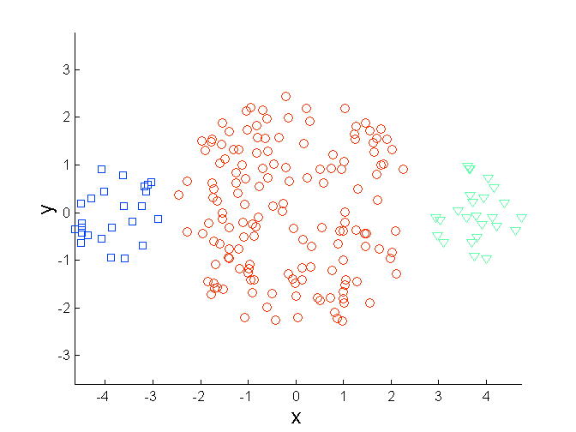
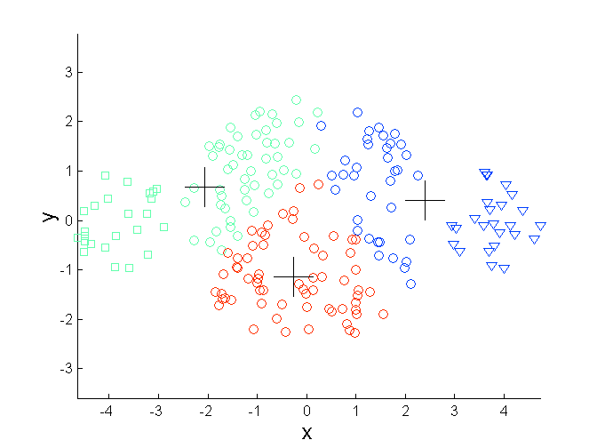
Limitations of K-means: Differing Sizes
Original Points
K-means (3 Clusters)

Slide 30
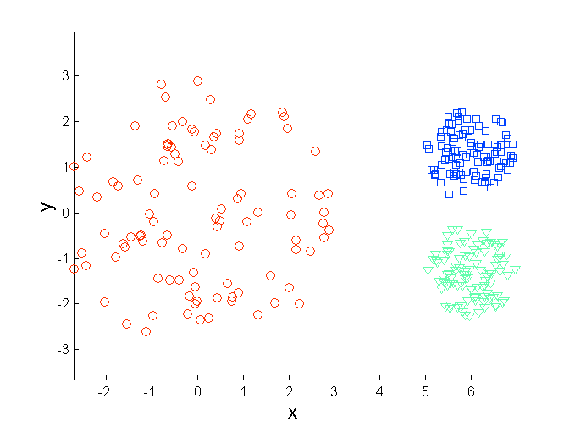
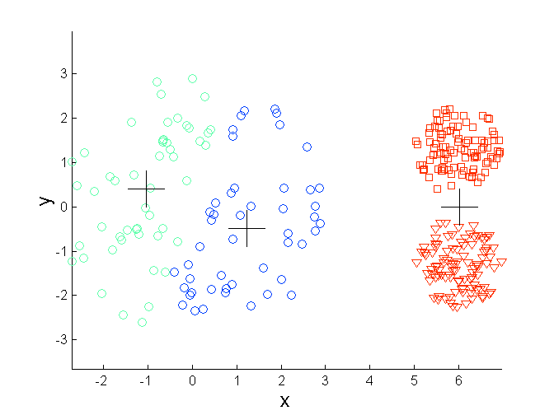
Limitations of K-means: Differing Density
Original Points
K-means (3 Clusters)

Slide 31
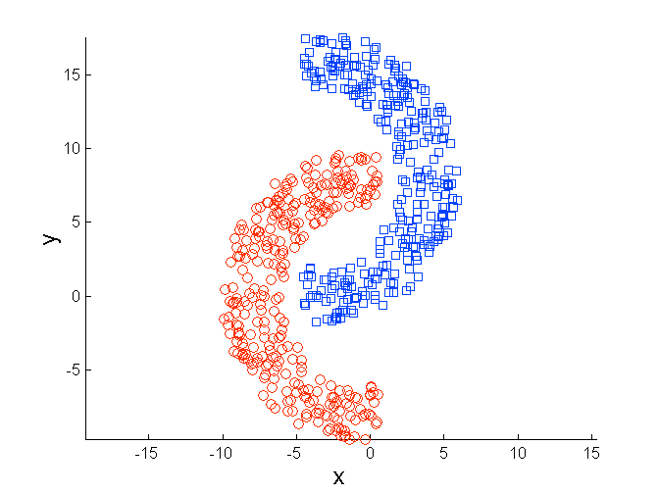
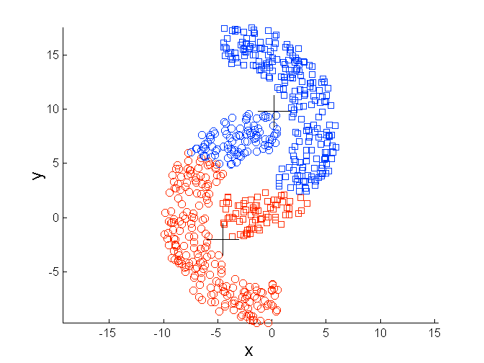
Limitations of K-means: Non-globular Shapes
Original Points
K-means (2 Clusters)

Slide 32
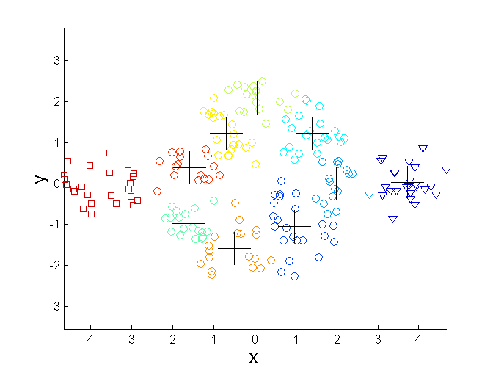
Overcoming K-means Limitations
Original Points K-means Clusters
One solution is to use many clusters.
Find parts of clusters, but need to put together.

Slide 33
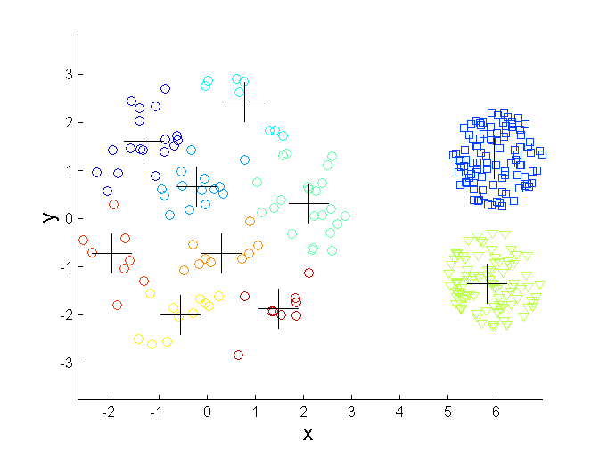
Overcoming K-means Limitations
Original Points K-means Clusters

Slide 34
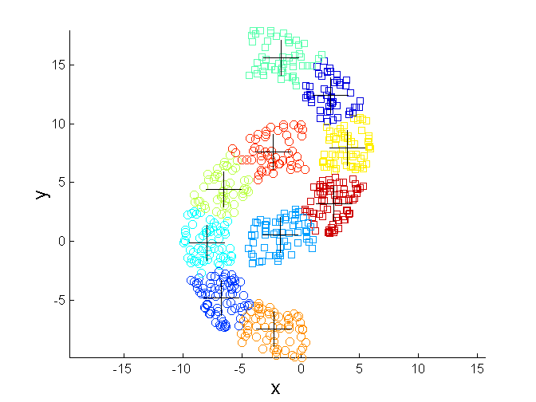
Overcoming K-means Limitations
Original Points K-means Clusters

Slide 35
HIERARCHICAL CLUSTERING

Slide 36
Hierarchical Clustering
Two main types of hierarchical clustering
Agglomerative（凝聚式）:
Start with the points as individual clusters
At each step, merge the closest pair of clusters until only one cluster (or k clusters) left
Divisive（分裂式）:
Start with one, all-inclusive cluster
At each step, split a cluster until each cluster contains a point (or there are k clusters)
Traditional hierarchical algorithms use a similarity or distance matrix
Merge or split one cluster at a time

Slide 37
Hierarchical Clustering
Produces a set of nested clusters organized as a hierarchical tree
Can be visualized as a dendrogram （树状图）or nested cluster diagram（嵌套簇图）
A tree like diagram that records the sequences of merges or splits
dendrogram

Slide 38
Strengths of Hierarchical Clustering
Do not have to assume any particular number of clusters
Any desired number of clusters can be obtained by ‘cutting’ the dendogram at the proper level
Dendrograms may correspond to meaningful taxonomies
Example in biological sciences (e.g., animal kingdom …)

Slide 39
Agglomerative Clustering Algorithm
Most popular hierarchical clustering technique
Basic algorithm is straightforward
Compute the proximity matrix
Let each data point be a cluster
Repeat
Merge the two closest clusters
Update the proximity matrix
Until only a single cluster remains
Key operation is the computation of the proximity of two clusters
Different approaches to defining the distance between clusters distinguish the different algorithms

Slide 40
Starting Situation
Start with single-point clusters and a proximity matrix between points
p1
p2
p3
p4
p5
. . .
p1
p2
p3
p4
p5
.
.
.
Proximity Matrix

Slide 41
Intermediate Situation
After some merging steps, we have some clusters and a proximity matrix between clusters
C1
C2
C3
C4
C5
C1
C2
C3
C3
C4
C4
C5
C1
Proximity Matrix
C2
C5

Slide 42
Intermediate Situation
We want to merge the two closest clusters (C2 and C5) and update the proximity matrix.
C1
C2
C3
C4
C5
C1
C2
C3
C3
C4
C4
C5
Proximity Matrix
C1
C2
C5

Slide 43
After Merging
The question is “How do we update the proximity matrix?”
C2 U C5
C1
C3
C4
C1
?
C2 U C5
? ? ? ?
C3
C3
?
C4
C4
?
C1
Proximity Matrix
C2 U C5

Slide 44
How to Define Inter-Cluster Similarity
p1
p2
p3
p4
p5
. . .
p1
Similarity?
p2
p3
p4
p5
MIN
MAX
Group Average
Distance Between Centroids
Other methods driven by an objective function
Ward’s Method uses squared error
.
.
.
Proximity Matrix

Slide 45
How to Define Inter-Cluster Similarity
p1
p2
p3
p4
p5
. . .
p1
p2
p3
p4
p5
MIN
MAX
Group Average
Distance Between Centroids
Other methods driven by an objective function
Ward’s Method uses squared error
.
.
.
Proximity Matrix

Slide 46
How to Define Inter-Cluster Similarity
p1
p2
p3
p4
p5
. . .
p1
p2
p3
p4
p5
MIN
MAX
Group Average
Distance Between Centroids
Other methods driven by an objective function
Ward’s Method uses squared error
.
.
.
Proximity Matrix

Slide 47
How to Define Inter-Cluster Similarity
p1
p2
p3
p4
p5
. . .
p1
p2
p3
p4
p5
MIN
MAX
Group Average
Distance Between Centroids
Other methods driven by an objective function
Ward’s Method uses squared error
.
.
.
Proximity Matrix

Slide 48
How to Define Inter-Cluster Similarity
p1
p2
p3
p4
p5
. . .
p1
×
×
p2
p3
p4
p5
MIN
MAX
Group Average
Distance Between Centroids
Other methods driven by an objective function
Ward’s Method uses squared error
.
.
.
Proximity Matrix

Slide 49
Single Link – Complete Link
Another way to view the processing of the hierarchical algorithm is that we create links between the elements in order of increasing distance
The MIN – Single Link, will merge two clusters when a single pair of elements is linked
The MAX – Complete Linkage will merge two clusters when all pairs of elements have been linked.

Slide 50
Hierarchical Clustering: MIN
 | 1 | 2 | 3 | 4 | 5 | 6
1 | 0 | .24 | .22 | .37 | .34 | .23
2 | .24 | 0 | .15 | .20 | .14 | .25
3 | .22 | .15 | 0 | .15 | .28 | .11
4 | .37 | .20 | .15 | 0 | .29 | .22
5 | .34 | .14 | .28 | .29 | 0 | .39
6 | .23 | .25 | .11 | .22 | .39 | 0
 | 1 | 2 | 3 | 4 | 5 | 6
1 | 0 | .24 | .22 | .37 | .34 | .23
2 | .24 | 0 | .15 | .20 | .14 | .25
3 | .22 | .15 | 0 | .15 | .28 | .11
4 | .37 | .20 | .15 | 0 | .29 | .22
5 | .34 | .14 | .28 | .29 | 0 | .39
6 | .23 | .25 | .11 | .22 | .39 | 0
 | 1 | 2 | 3 | 4 | 5 | 6
1 | 0 | .24 | .22 | .37 | .34 | .23
2 | .24 | 0 | .15 | .20 | .14 | .25
3 | .22 | .15 | 0 | .15 | .28 | .11
4 | .37 | .20 | .15 | 0 | .29 | .22
5 | .34 | .14 | .28 | .29 | 0 | .39
6 | .23 | .25 | .11 | .22 | .39 | 0
 | 1 | 2 | 3 | 4 | 5 | 6
1 | 0 | .24 | .22 | .37 | .34 | .23
2 | .24 | 0 | .15 | .20 | .14 | .25
3 | .22 | .15 | 0 | .15 | .28 | .11
4 | .37 | .20 | .15 | 0 | .29 | .22
5 | .34 | .14 | .28 | .29 | 0 | .39
6 | .23 | .25 | .11 | .22 | .39 | 0
 | 1 | 2 | 3 | 4 | 5 | 6
1 | 0 | .24 | .22 | .37 | .34 | .23
2 | .24 | 0 | .15 | .20 | .14 | .25
3 | .22 | .15 | 0 | .15 | .28 | .11
4 | .37 | .20 | .15 | 0 | .29 | .22
5 | .34 | .14 | .28 | .29 | 0 | .39
6 | .23 | .25 | .11 | .22 | .39 | 0
 | 1 | 2 | 3 | 4 | 5 | 6
1 | 0 | .24 | .22 | .37 | .34 | .23
2 | .24 | 0 | .15 | .20 | .14 | .25
3 | .22 | .15 | 0 | .15 | .28 | .11
4 | .37 | .20 | .15 | 0 | .29 | .22
5 | .34 | .14 | .28 | .29 | 0 | .39
6 | .23 | .25 | .11 | .22 | .39 | 0
 | 1 | 2 | 3 | 4 | 5 | 6
1 | 0 | .24 | .22 | .37 | .34 | .23
2 | .24 | 0 | .15 | .20 | .14 | .25
3 | .22 | .15 | 0 | .15 | .28 | .11
4 | .37 | .20 | .15 | 0 | .29 | .22
5 | .34 | .14 | .28 | .29 | 0 | .39
6 | .23 | .25 | .11 | .22 | .39 | 0
5
1
3
5
2
1
2
3
6
4
4
Nested Clusters
Dendrogram

Slide 51
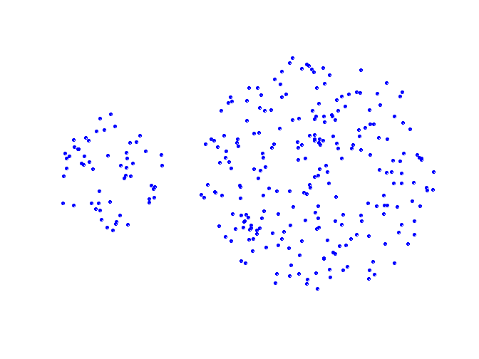
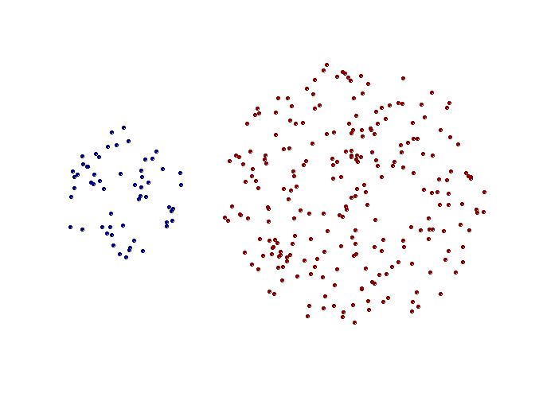
Strength of MIN
Original Points
Two Clusters
Can handle non-elliptical shapes
single link method is also called nearest neighbor method.

Slide 52
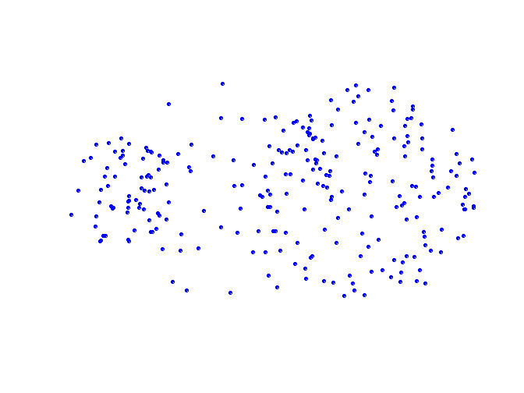
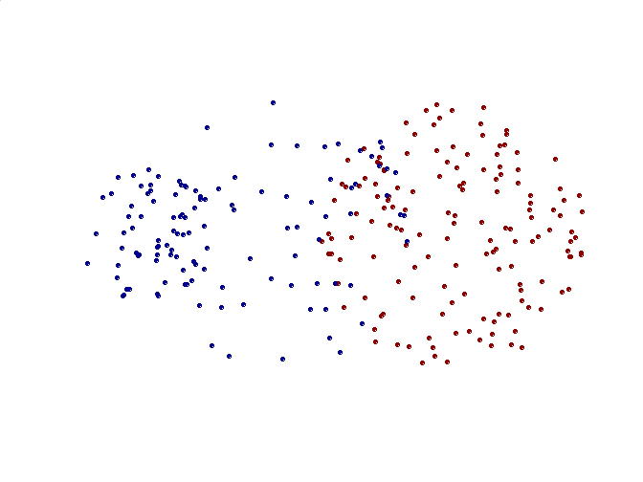
Limitations of MIN
Original Points
Two Clusters
Sensitive to noise and outliers

Slide 53
Hierarchical Clustering: MAX
 | 1 | 2 | 3 | 4 | 5 | 6
1 | 0 | .24 | .22 | .37 | .34 | .23
2 | .24 | 0 | .15 | .20 | .14 | .25
3 | .22 | .15 | 0 | .15 | .28 | .11
4 | .37 | .20 | .15 | 0 | .29 | .22
5 | .34 | .14 | .28 | .29 | 0 | .39
6 | .23 | .25 | .11 | .22 | .39 | 0
 | 1 | 2 | 3 | 4 | 5 | 6
1 | 0 | .24 | .22 | .37 | .34 | .23
2 | .24 | 0 | .15 | .20 | .14 | .25
3 | .22 | .15 | 0 | .15 | .28 | .11
4 | .37 | .20 | .15 | 0 | .29 | .22
5 | .34 | .14 | .28 | .29 | 0 | .39
6 | .23 | .25 | .11 | .22 | .39 | 0
 | 1 | 2 | 3 | 4 | 5 | 6
1 | 0 | .24 | .22 | .37 | .34 | .23
2 | .24 | 0 | .15 | .20 | .14 | .25
3 | .22 | .15 | 0 | .15 | .28 | .11
4 | .37 | .20 | .15 | 0 | .29 | .22
5 | .34 | .14 | .28 | .29 | 0 | .39
6 | .23 | .25 | .11 | .22 | .39 | 0
 | 1 | 2 | 3 | 4 | 5 | 6
1 | 0 | .24 | .22 | .37 | .34 | .23
2 | .24 | 0 | .15 | .20 | .14 | .25
3 | .22 | .15 | 0 | .15 | .28 | .11
4 | .37 | .20 | .15 | 0 | .29 | .22
5 | .34 | .14 | .28 | .29 | 0 | .39
6 | .23 | .25 | .11 | .22 | .39 | 0
 | 1 | 2 | 3 | 4 | 5 | 6
1 | 0 | .24 | .22 | .37 | .34 | .23
2 | .24 | 0 | .15 | .20 | .14 | .25
3 | .22 | .15 | 0 | .15 | .28 | .11
4 | .37 | .20 | .15 | 0 | .29 | .22
5 | .34 | .14 | .28 | .29 | 0 | .39
6 | .23 | .25 | .11 | .22 | .39 | 0
 | 1 | 2 | 3 | 4 | 5 | 6
1 | 0 | .24 | .22 | .37 | .34 | .23
2 | .24 | 0 | .15 | .20 | .14 | .25
3 | .22 | .15 | 0 | .15 | .28 | .11
4 | .37 | .20 | .15 | 0 | .29 | .22
5 | .34 | .14 | .28 | .29 | 0 | .39
6 | .23 | .25 | .11 | .22 | .39 | 0
 | 1 | 2 | 3 | 4 | 5 | 6
1 | 0 | .24 | .22 | .37 | .34 | .23
2 | .24 | 0 | .15 | .20 | .14 | .25
3 | .22 | .15 | 0 | .15 | .28 | .11
4 | .37 | .20 | .15 | 0 | .29 | .22
5 | .34 | .14 | .28 | .29 | 0 | .39
6 | .23 | .25 | .11 | .22 | .39 | 0
 | 1 | 2 | 3 | 4 | 5 | 6
1 | 0 | .24 | .22 | .37 | .34 | .23
2 | .24 | 0 | .15 | .20 | .14 | .25
3 | .22 | .15 | 0 | .15 | .28 | .11
4 | .37 | .20 | .15 | 0 | .29 | .22
5 | .34 | .14 | .28 | .29 | 0 | .39
6 | .23 | .25 | .11 | .22 | .39 | 0
 | 1 | 2 | 3 | 4 | 5 | 6
1 | 0 | .24 | .22 | .37 | .34 | .23
2 | .24 | 0 | .15 | .20 | .14 | .25
3 | .22 | .15 | 0 | .15 | .28 | .11
4 | .37 | .20 | .15 | 0 | .29 | .22
5 | .34 | .14 | .28 | .29 | 0 | .39
6 | .23 | .25 | .11 | .22 | .39 | 0
 | 1 | 2 | 3 | 4 | 5 | 6
1 | 0 | .24 | .22 | .37 | .34 | .23
2 | .24 | 0 | .15 | .20 | .14 | .25
3 | .22 | .15 | 0 | .15 | .28 | .11
4 | .37 | .20 | .15 | 0 | .29 | .22
5 | .34 | .14 | .28 | .29 | 0 | .39
6 | .23 | .25 | .11 | .22 | .39 | 0
 | 1 | 2 | 3 | 4 | 5 | 6
1 | 0 | .24 | .22 | .37 | .34 | .23
2 | .24 | 0 | .15 | .20 | .14 | .25
3 | .22 | .15 | 0 | .15 | .28 | .11
4 | .37 | .20 | .15 | 0 | .29 | .22
5 | .34 | .14 | .28 | .29 | 0 | .39
6 | .23 | .25 | .11 | .22 | .39 | 0
4
1
2
5
5
2
3
6
3
1
4
Nested Clusters
Dendrogram

Slide 54
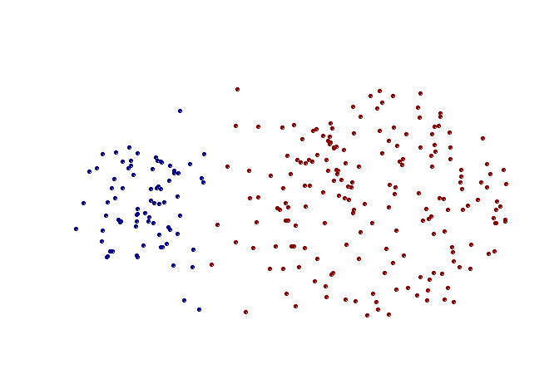
Strength of MAX
Original Points
Two Clusters
Less susceptible to noise and outliers

Slide 55
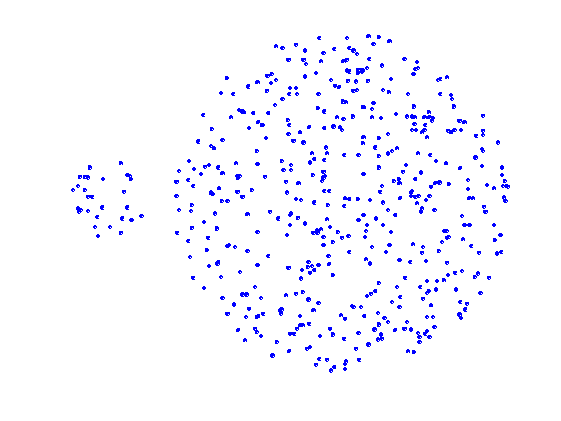
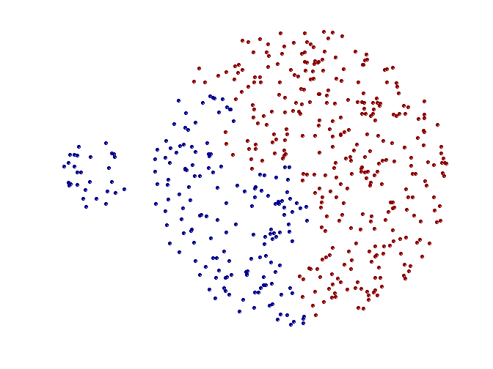
Limitations of MAX
Original Points
Two Clusters
Tends to break large clusters
Biased towards globular clusters

Slide 56
Hierarchical Clustering: Group Average
 | 1 | 2 | 3 | 4 | 5 | 6
1 | 0 | .24 | .22 | .37 | .34 | .23
2 | .24 | 0 | .15 | .20 | .14 | .25
3 | .22 | .15 | 0 | .15 | .28 | .11
4 | .37 | .20 | .15 | 0 | .29 | .22
5 | .34 | .14 | .28 | .29 | 0 | .39
6 | .23 | .25 | .11 | .22 | .39 | 0
5
4
1
2
5
2
3
6
1
4
3
Nested Clusters
Dendrogram

Slide 57
Hierarchical Clustering: Group Average
Compromise between Single and Complete Link
Strengths
Less susceptible to noise and outliers
Limitations
Biased towards globular clusters

Slide 58
Hierarchical Clustering: Time and Space requirements
O(N²) space since it uses the proximity matrix.
N is the number of points.
O(N³) time in many cases
There are N steps and at each step the size N² proximity matrix must be updated and searched

Slide 59
Hierarchical Clustering: Problems and Limitations
Computational complexity in time and space
Once a decision is made to combine two clusters, it cannot be undone
No objective function is directly minimized
Different schemes have problems with one or more of the following:
Sensitivity to noise and outliers
Difficulty handling different sized clusters and convex shapes
Breaking large clusters
《技术挖掘导论》P327

